Slide 1
CS2006 Operating Systems
SPRING 2023
National University of Computer and Emerging Sciences

Slide 2
Deadlock
Chapter#6, William Stallings

Slide 3
A set of processes is deadlocked, when each process in the set is blocked awaiting an event that can only be triggered by another blocked process in the set.

Slide 4
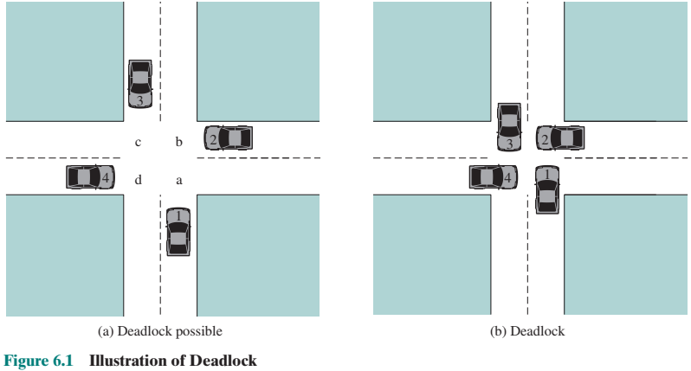

Slide 5
Conditions for possible Deadlock
Mutual exclusion (non-sharable resources)
Only one process may use a resource at a time
Hold-and-wait
A process may hold allocated resources while awaiting assignment of others
No pre-emption
No resource can be forcibly removed from a process holding it
Notes:
All three must be present for deadlock to occur.

Slide 6
Actual Deadlock Requires …
All previous 3 conditions plus:
Circular wait
A closed chain of processes exists, such that each process holds at least one resource needed by the next process in the chain.

Slide 7
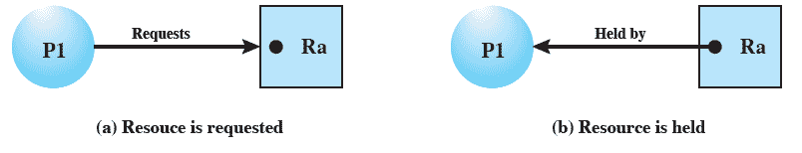
Resource Allocation Graph
Directed graph that depicts a state of the system of resources and processes

Slide 8
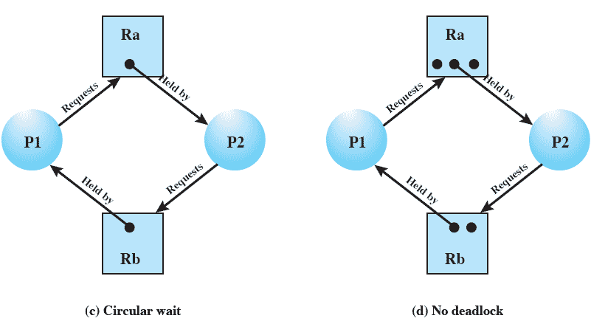

Slide 9
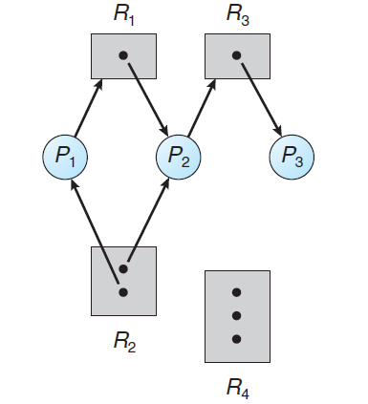
Resource instances:
One instance of resource type R1
Two instances of resource type R2
One instance of resource type R3
Three instances of resource type R4
Process states:
Process P1 is holding an instance of resource type R2 and is waiting for an instance of resource type R1.
Process P2 is holding an instance of R1 and an instance of R2 and is waiting for an instance of R3.
Process P3 is holding an instance of R3.

Slide 10
P1
F1
P2
F2
P3
F3
P4
F4
P5
F5

Slide 11
Dealing with Deadlock
Three general approaches exist for dealing with deadlock.
Prevent deadlock
Avoid deadlock
Detect Deadlock

Slide 12
Deadlock Prevention
We can view deadlock prevention methods as falling into two classes.
An indirect method of deadlock prevention is to prevent the occurrence of one of the three necessary conditions:
Mutual Exclusion
Hold and Wait
No Preemption
A direct method of deadlock prevention is to prevent the occurrence of a circular wait (item 4)

Slide 13
Deadlock Prevention
In general, mutual exclusion cannot be disallowed.
If access to a resource requires mutual exclusion, then mutual exclusion must be supported by the OS
The hold-and-wait condition can be prevented by requiring that a process request all of its required resources at one time and blocking the process until all requests can be granted simultaneously
This approach is inefficient in two ways. First, a process may be held up for a long time waiting for all of its resource requests to be filled, when in fact it could have proceeded with only some of the resources.
Second, resources allocated to a process may remain unused for a considerable period, during which time they are denied to other processes

Slide 14
Deadlock Prevention
No Preemption can be prevented in several ways.
First, if a process holding certain resources is denied a further request, that process must release its original resources and, if necessary, request them again together with the additional resource.
Alternatively, if a process requests a resource that is currently held by another process, the OS may preempt the second process and require it to release its resources.

Slide 15
Deadlock Prevention
No Preemption can be prevented in several ways.
First, if a process holding certain resources is denied a further request, that process must release its original resources and, if necessary, request them again together with the additional resource.
Alternatively, if a process requests a resource that is currently held by another process, the OS may preempt the second process and require it to release its resources.

Slide 16
Deadlock Prevention
Circular wait condition can be prevented by defining a linear ordering of resource types.
If a process has been allocated resources of type R, then it may subsequently request only those resources of types following R in the ordering
Let us associate an index with each resource type. Then resource Ri precedes Rj in the ordering if i < j.
Now suppose two processes, A and B, are deadlocked because A has acquired Ri and requested Rj, and B has acquired Rj and requested Ri. This condition is impossible because it implies i < j and j < i

Slide 17
DEADLOCK AVOIDANCE
Deadlock avoidance, allows the three necessary conditions but makes judicious choices to assure that the deadlock point is never reached
A decision is made dynamically whether the current resource allocation request will, if granted, potentially lead to a deadlock
Requires knowledge of future process requests

Slide 18
The two approaches to deadlock avoidance are:
Process Initiation Denial: Do not start a process if its demands might lead to deadlock
Resource Allocation Denial: Do not grant an incremental resource request to a process if this allocation might lead to deadlock.

Slide 19
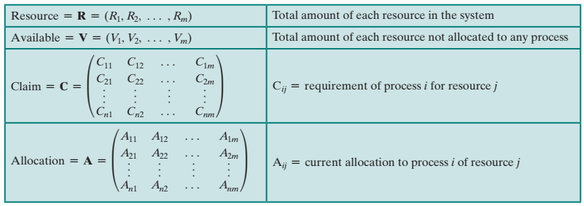

Slide 20
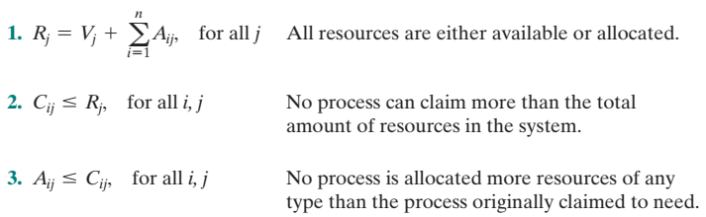

Slide 21

Process Initiation Denial
With these quantities defined, Start a new process P_{n + 1} only if
if the maximum claim of all current processes plus those of the new process can be met

Slide 22

Resource Allocation Denial
Banker’s Algorithm
The state of the system reflects the current allocation of resources to processes.
A safe state is one in which there is at least one sequence of resource allocations to processes that does not result in a deadlock (i.e., all of the processes can be run to completion).
An unsafe state is, of course, a state that is not safe.
can the difference between the maximum requirement and current allocation for any process be met with the available resources

Slide 23
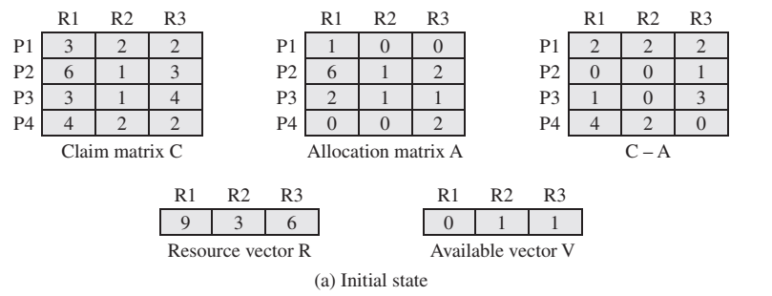

Slide 24
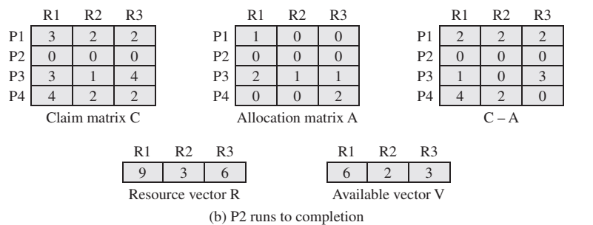

Slide 25
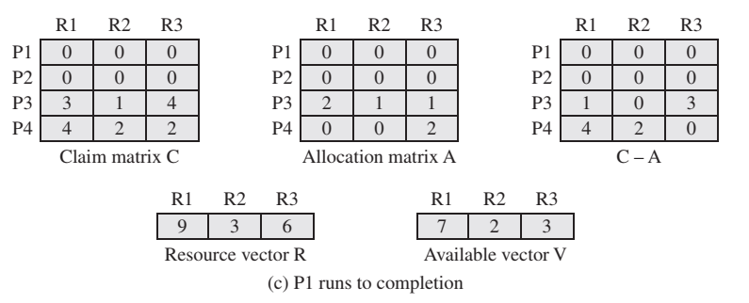

Slide 26
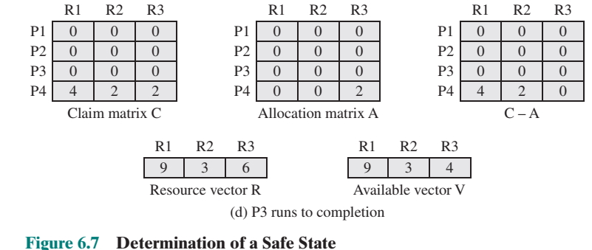

Slide 27
Resource-Request Algorithm for Process P_{i}
Request_{i} = request vector for process P_{i}. If Request_{i} [j] = k then process P_{i} wants k instances of resource type R_{j}
1. If Request_{i} ≤ Need_{i} go to step 2. Otherwise, raise error condition, since process has exceeded its maximum claim
2. If Request_{i} ≤ Available, go to step 3. Otherwise, P_{i} must wait, since resources are not available
3. Pretend to allocate requested resources to P_{i} by modifying the state as follows:
Available = Available – Request_{i};
Allocation_{i} = Allocation_{i} + Request_{i};
Need_{i} = Need_{i} – Request_{i};
If safe ⇒ the resources are allocated to P_{i}
If unsafe ⇒ P_{i} must wait, and the old resource-allocation state is restored

Slide 28
Deadlock Detection Algorithm
The algorithm uses Allocation matrix and Available vector described in the previous section are used.
In addition, a request matrix Q is defined such that Q_{ij} represents the amount of resources of type j requested by process I

Slide 29
Initially, all processes are unmarked. Then the following steps are performed:
Mark each process that has a row in the Allocation matrix of all zeros.
A process that has no allocated resources cannot participate in a deadlock.
Initialize a temporary vector W to equal the Available vector
Find an index i such that process i is currently unmarked and the i^{th} row of Q is less than or equal to W. If no such row is found, terminate the algorithm
If such a row is found, mark process i and add the corresponding row of the allocation matrix to W. Return to step 3.
A deadlock exists if and only if there are unmarked processes at the end of the algorithm

Slide 30
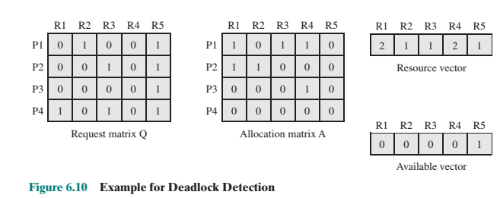

Slide 31
Deadlock Recovery
Once deadlock has been detected, some strategy is needed for recovery:
Abort all deadlocked processes
Back up each deadlocked process to some previously defined checkpoint, and restart all processes
Successively abort deadlocked processes until deadlock no longer exists
Successively preempt resources until deadlock no longer exists

Slide 32
For (3) and (4), the selection criteria could be one of the following, Choose the process with the :
least amount of processor time consumed so far
least amount of output produced so far
most estimated time remaining
least total resources allocated so far
lowest priority

